Slide 1
Line-to-line voltage and line current (experimental)
300 Hz fundamental frequency
10kHz switching frequency
2.5 Mhz sampling frequency
Zoom in

Slide 2
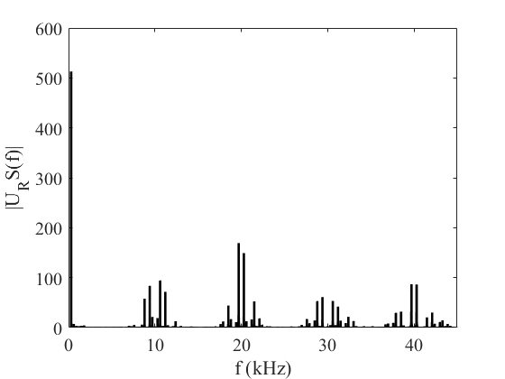
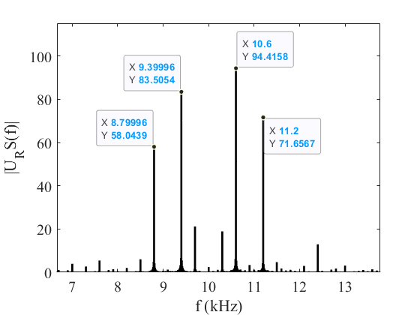
FFT Analysis (Voltage)
Zoom in
Unwanted harmonics near the sidebands due to FFT process

Slide 3
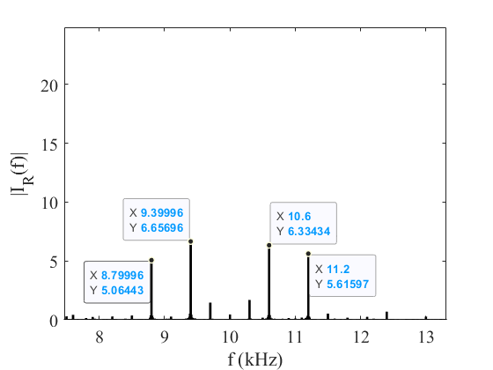
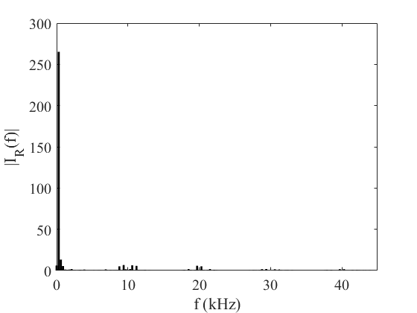
FFT Analysis (Current)
Zoom in

Slide 4
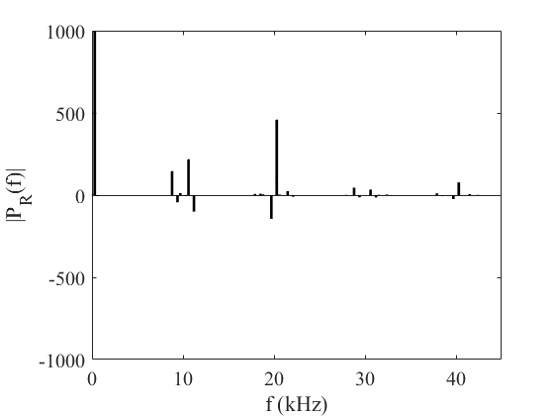
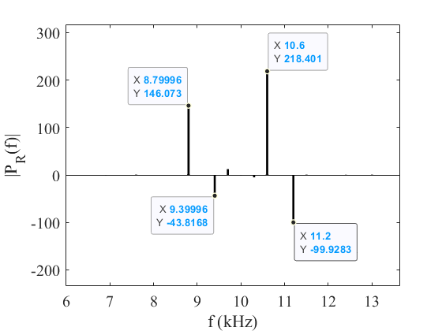
FFT Analysis (Power)
Zoom in
Why are some harmonics generating power? Saliency?

Slide 5
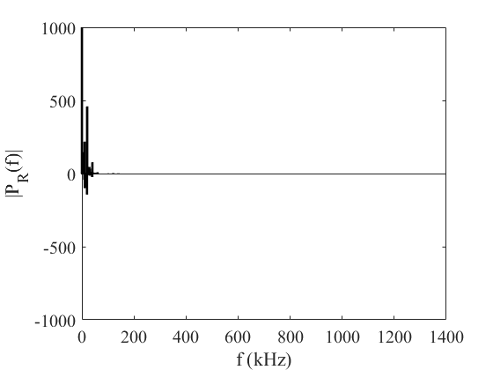
All harmonics
Fundamental power= 112.3 kW
Harmonic Losses= 981 W

